Slide 1
SC1015
Mini Project
Loan Status Predictor
Group 3
Madhumita Thiruppathi
Ponnusamy Saishenetha
Sukainah Begam
Notes:
Hello we are from group 3 and this is our 1015 mini project on Loan Status Predictor

Slide 2

Motivation & Problem Statement
To mitigate financial risk for lenders
Aid lending institutions in assessing the creditworthiness of loan applicants and to make informed decisions to minimize potential losses due to defaults
The objective is to develop a predictive model that can accurately forecast the likelihood of future loans
Notes:
The main motivation behind our project to predict whether a person would pay off their loan or not is to mitigate financial risk for lenders.
Our project will aid lending institutions in assessing the creditworthiness of loan applicants and making informed decisions to minimize potential losses due to defaults. The objective is to develop a predictive model that can accurately forecast the likelihood of future loans.

Slide 3
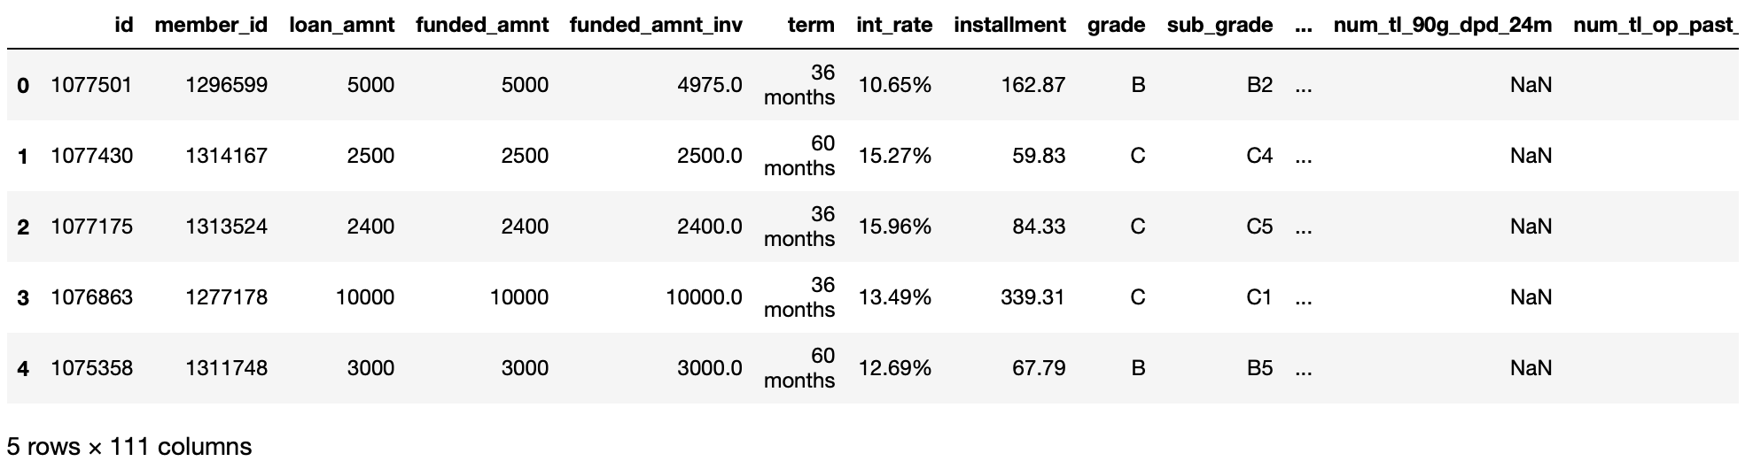
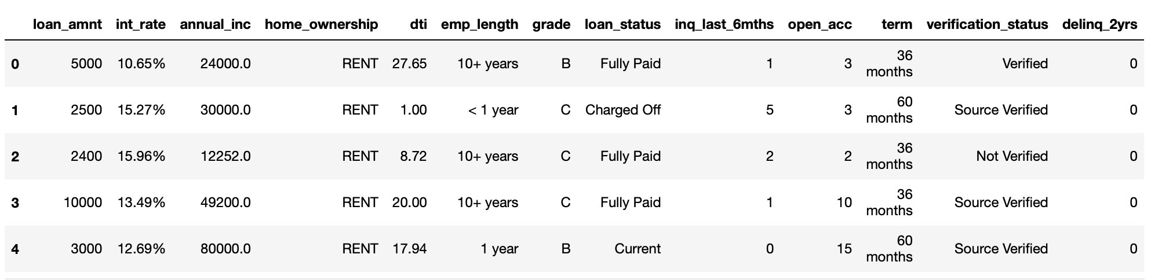
Data
Removed all the columns which had NaN values and other columns which were not required for determining the loan status
Notes:
We got our loan dataset from kaggle which was initially as an xls file and was converted to a csv. From the 111 columns, we removed columns with NaN values and those which were of no help in predicting the loan status. For example columns like purpose which examine the purposes for which loans are taken, help to identify common reasons for borrowing but will not be much of a use in predicting whether they will pay back the loan or not.

Slide 4

Cleaning
Removed % sign from int_rate
Separate Numeric Data & Categorical Data
Remove outliers and then replace NaN values with the respective mean value of each column
Replace NaN values in Categorical Data with mode value
Notes:
The cleaning process of the data started off from converting the interest rate to a numeric data and splitting up numerical and categorical datas.
In order to fill in the NaN values for numerical data we used the mean of each column. However the mean may not accurately represent the central tendency of the data if there are outliers and Thus we removed the outliers before calculating the mean.
Since mode represents the most common category in the dataset, we used it to fill NaN values for the categorical data in order to ensure that the overall distribution of the variable remains relatively unchanged.

Slide 5

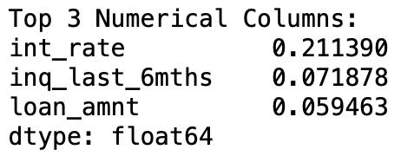
Top 3 Columns (Numerical Data)
Remove (‘Current’) from loan status
Convert Loan Status categories into binary values (ie: 001 & 010)
Calculate the correlation of loan status against all the numeric values
Notes:
To identify our top 3 numerical data, we calculated the correlation of numeric data against loan status which was converted into binary values. We also removed ‘Current’ from loan_status as our main objective is to identify people who pay their loan, ongoing loan applications will be of no help. Our top 3 numerical data are interest rate, inquires in the last 6 months and loan amount.

Slide 6
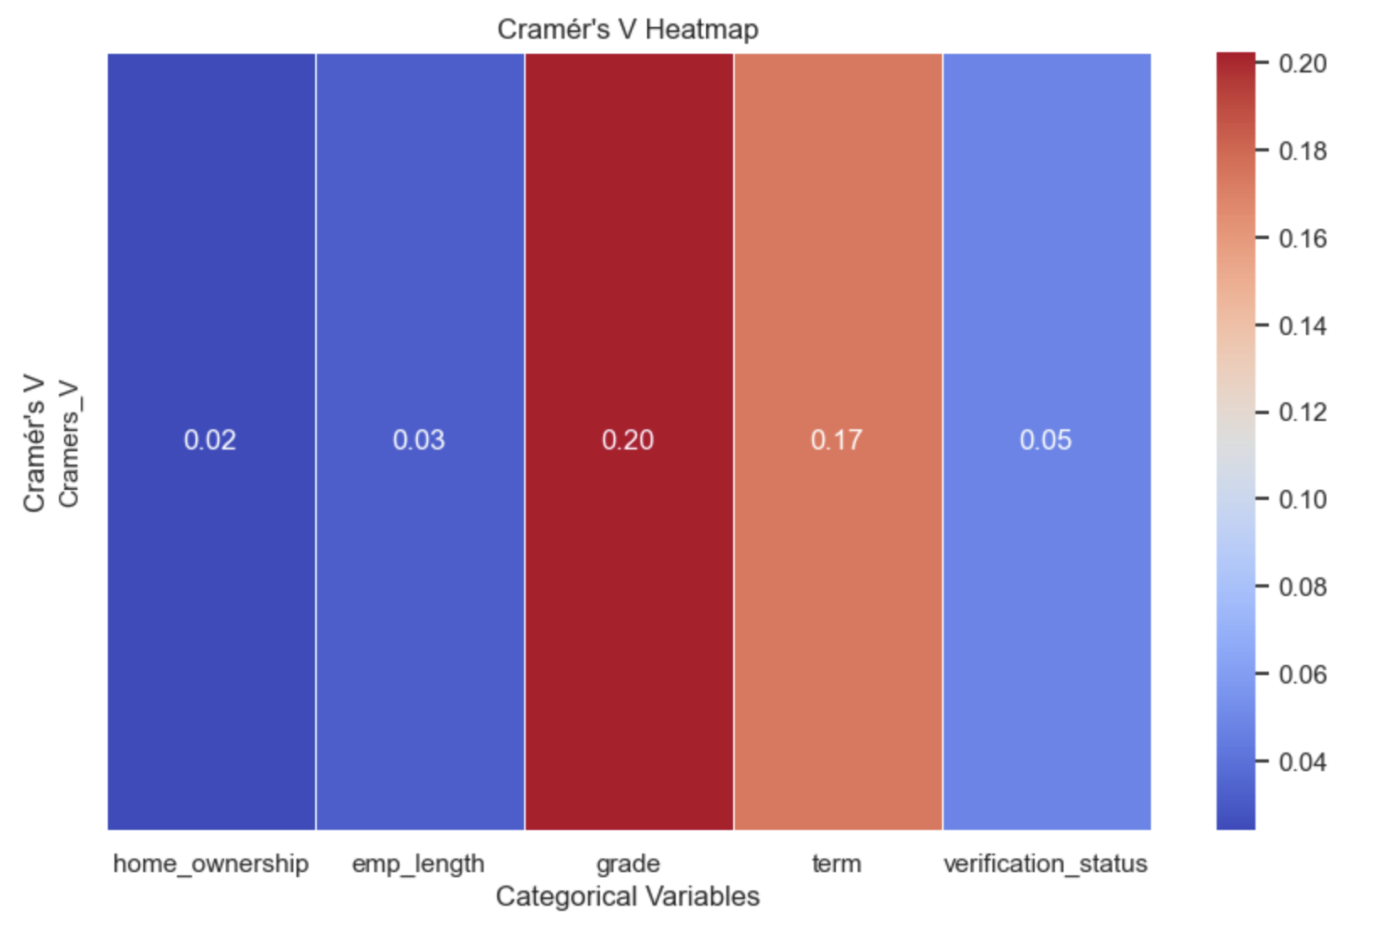
Top 3 Columns (Categorical Data)
Cramér's V Statistic to find the top 3 categorical values
Calculate Chi-Square Values and normalize using Cramér's V formula
Display the values on a heatmap
Top 3 Categorical Columns:
grade 0.20
term 0.17
verification_status 0.05
Notes:
To identify the top 3 categorical data we used Cramers V.
Cramer's V not only tells you if there is an association between two categorical variables, but also quantifies the strength of that association. Higher values indicate stronger relationship, making it straightforward to identify the top 3 categorical variables.
Cramers V uses the chi-squared statistic which is then normalized using Cramér's V formula, considering the total number of observations (n) and the minimum dimension of the contingency table. The square root of the normalized chi-squared statistic yields the Cramér's V value. The top 3 categorical columns are grade, term and verification status.

Slide 7
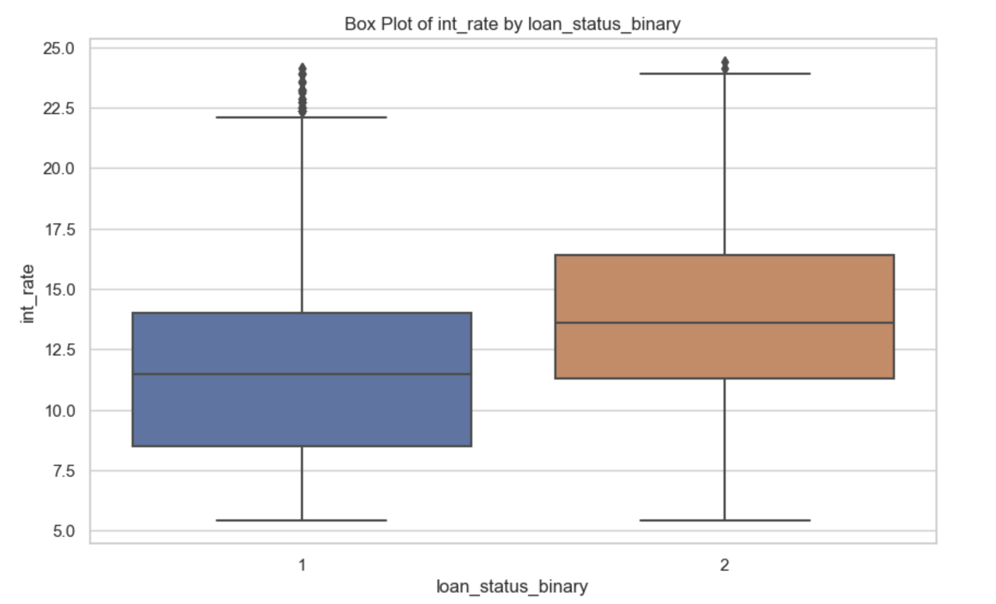
EDA for Numerical Data
Interest rate by Loan Status Binary
The median interest rate for charged off loans is higher than the median interest rate for fully paid off loans in a box plot, it indicates a potential association between higher interest rates and loan default.
Lenders may need to reconsider their risk assessment strategies as boxplot results suggest that lending to riskier borrowers at higher rates might not always mitigate the risk of default.
Notes:
Lets now look at the EDA for numerical data. Firstly we gave interest rate. The box plot analysis suggests a potential association between higher interest rates and loan default, as the median interest rate for charged off loans is higher than that of fully paid off loans. This shows lenders to reconsider their risk assessment strategies, as lending to riskier borrowers at higher rates may not effectively mitigate the risk of default.

Slide 8
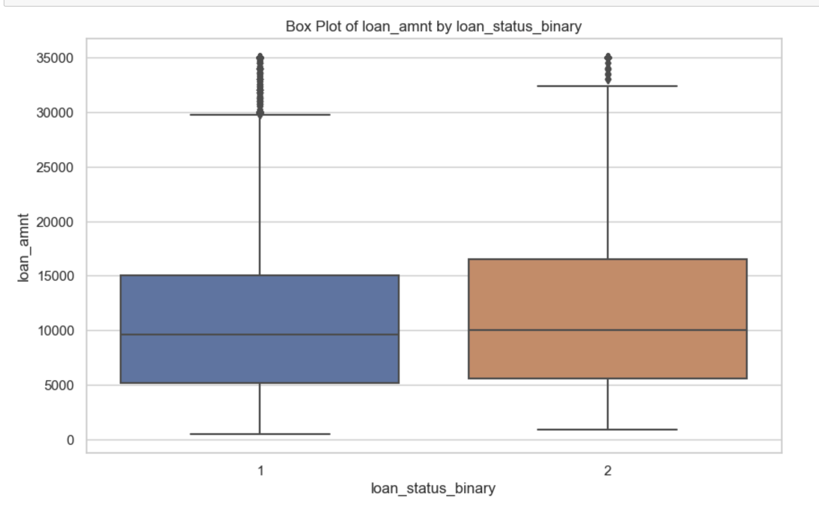
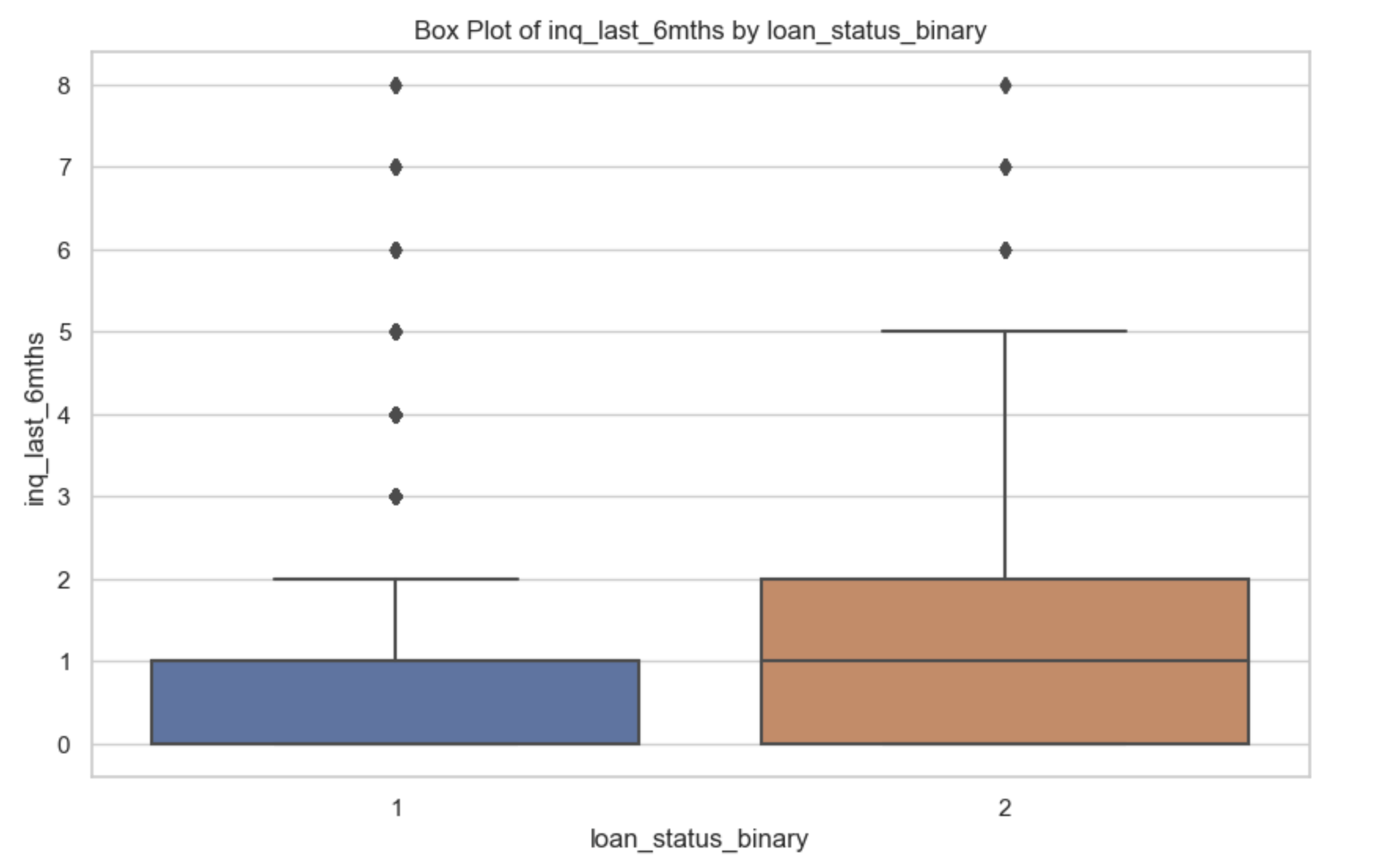
EDA for Numerical Data
Loan Amount by Loan Status Binary
Inquiries in last 6 month by Loan Status Binary
Similar median values indicate that loan amount is not strong predictors for determining whether a person will default a loan.
Borrowers who defaulted on their loans (charged_off) show a median of 1 inquiry in the last 6 months, contrasting with borrowers who fully paid their loans, where the median is 0 inquiries ,implying that higher recent inquiry activity is associated with a greater likelihood of defaulting on loans.
Notes:
Next is loan amount and the box plot shows that Loan amount is not a strong predictor for loan default.
Lastly we have inquiries in the last 6 months plotted against loan status. Borrowers who didn't repay their loans (charged off) typically had 1 recent inquiry in the last 6 months, while those who fully repaid had no recent inquiries. This suggests that having more recent inquiries is linked to a higher chance of loan default. Which makes sense because Generally, having more recent inquiries could indicate that borrowers are actively seeking credit, which might suggest financial instability or increased debt burden, potentially leading to a higher likelihood of defaulting on loans.

Slide 9
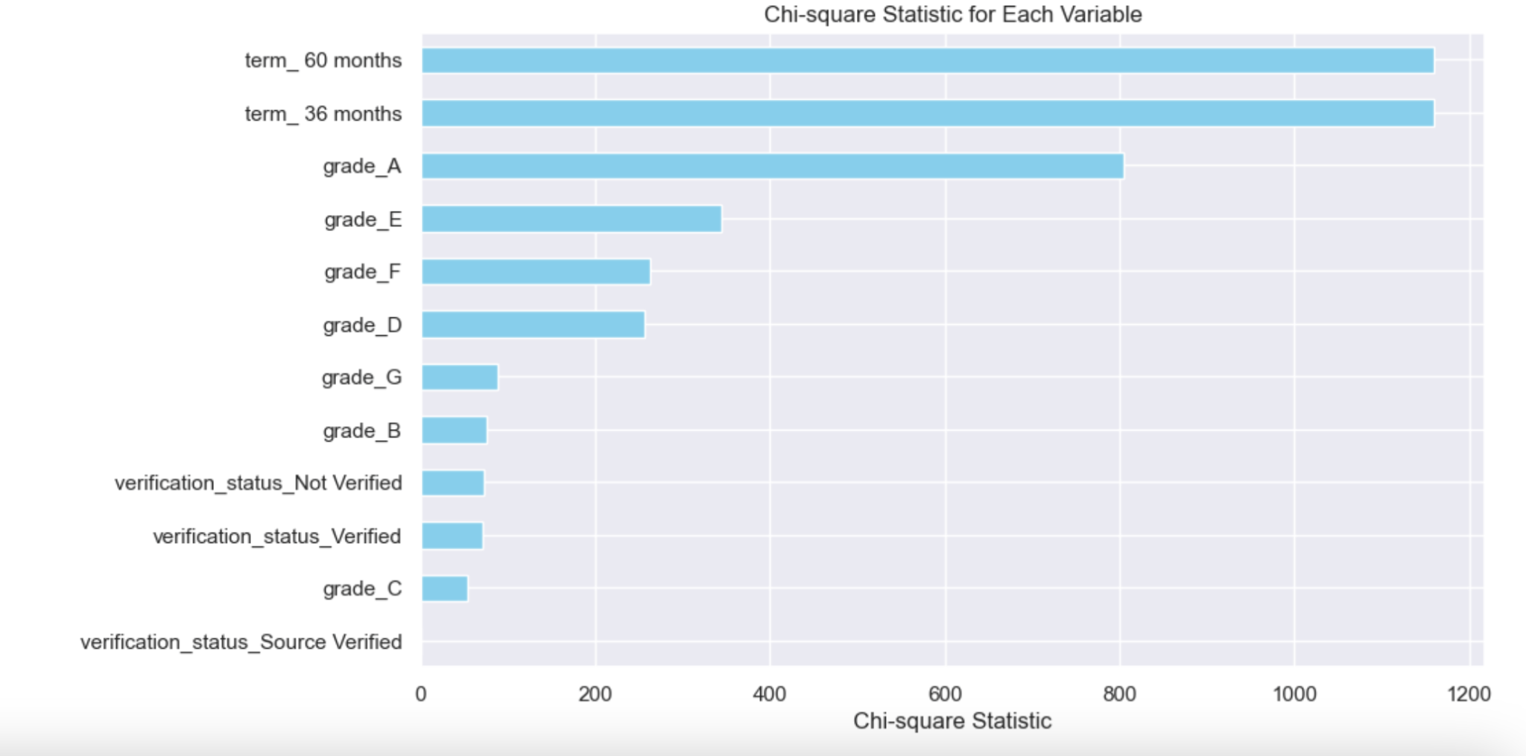
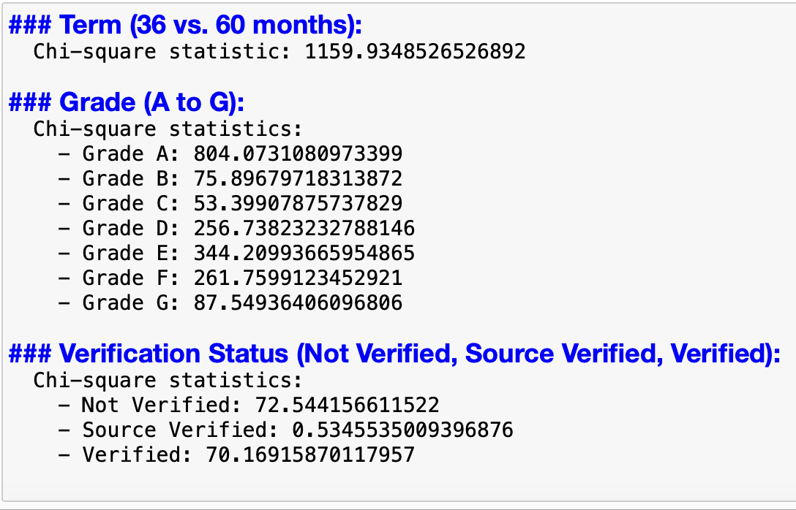
EDA for Categorical Data
Notes:
Next we conducted chi-square tests which was something new that we wanted to attempt executing . so we used chi square test to help us to evaluate the association between each categorical variable, encoded using one-hot encoding and plotted a horizontal bar chart to visualize the chi-square statistic for each variable .

Slide 10
EDA Categorical Data
Based on the chi-square statistics, the term variable (36 vs. 60 months) appears to have the strongest association with loan status, followed by the grade variable, particularly grade A, and then the verification status variable.
Chi-square statistic ,
Association with loan status
Notes:
The highest chi-square statistic is associated with the (36 month or 60 month )term variable (1159.93), meaning that it has a strong association with loan status.
Among the grade categories, the highest chi-square statistic is for grade A (804.07), followed by grade E (344.21). This suggests that grade A has the strongest association with loan status among the grade categories.
For the verification status categories, the highest chi-square statistic is for 'Not Verified' (72.54), followed by 'Verified' (70.17). The chi-square statistic for 'Source Verified' is much lower (0.53), indicating a weaker association with loan status compared to the other verification statuses.
Therefore in summary, the term variable (36 vs. 60 months) appears to have the strongest association with loan status, followed by the grade variable, particularly grade A, and then the verification status variable.

Slide 11
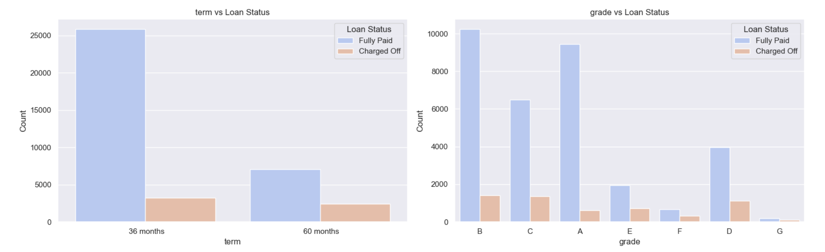
EDA Categorical Data
Term:
Loans with a 36-month term have higher counts of both charged off and fully paid statuses compared to loans with a 60-month term.
Overall, loans with shorter terms tend to have higher counts of fully paid statuses.
Grade:
Fully paid loans generally outnumber charged off loans across all grades.
Lower-grade loans (grades D to G) have higher counts of charged off loans, indicating higher default rates then when compared to higher-grade loans(grades A-C).
Notes:
Now looking into each categorically variable individually
For term Overall, loans with shorter terms tend to have higher counts of fully paid statuses.
For grade :
Fully paid loans generally outnumber charged off loans across all grades.
Lower-grade loans (grades D to G) have higher counts of charged off loans, indicating higher default rates for lower grade loans.

Slide 12
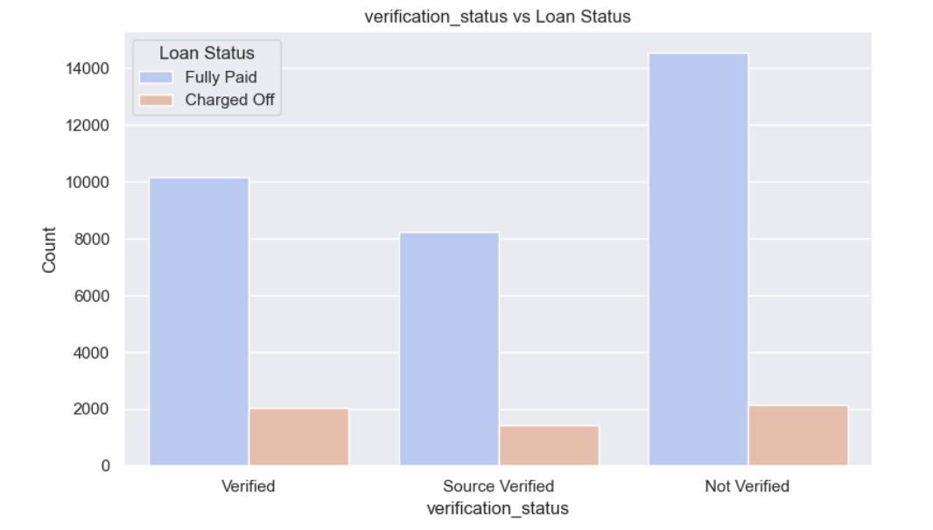

EDA Categorical Data
Verification Status:
The counts analysis of "verification_status" indicates that a significant number of loans were not verified, with "Not Verified" loans being the most prevalent.
Despite being fewer in number, both "Verified" and "Source Verified" loans exhibit almost similar count of ‘Charged off’ loans as “Not Verified”.
This is surprising as it is expected that verified loans to have a lower default rate due to the verification process confirming the borrower's financial stability.
Notes:
The counts analysis of "verification_status" indicates that a significant number of loans were not verified, with "Not Verified" loans being the most prevalent. Despite being fewer in number, both "Verified" and "Source Verified" loans exhibit almost similar count of ‘Charged off’ loans as “Not Verified”.
This is surprising as it is expected that verified loans would have a lower default rate due to the verification process confirming the borrower's financial stability.
However, the higher counts of defaults among verified loans suggest that other factors other than verification that may influence loan repayment behavior. This highlights the complexity of loan default prediction and emphasises the need for comprehensive risk assessment models that consider multiple factors beyond verification status.

Slide 13

Process of Training the Models
Imbalance Dataset:
Upsampling/
Downsampling
Hyperparameter Tuning:
Randomized Search Cross-Validation
Classification Accuracy: accuracy_score
Confusion Matrix:
Showing TPR, FPR, TNR & FNR
Loan_status
VS merged_data_cleaned
1. Term
2. Grade
3. Verification status
4. Interest rate
5. Loan amount
6. Inquiries in the last 6 months
Legend:
Red: Categorical Data
Blue: Numerical Data
Training: 70% of data
Testing: 30% of data
Categorical Variables:
Uses LabelEncoder
Numerical Variables:
Uses StandardScaler
Models:
1. Decision Tree Classifier
2. Logistic Regression
3. Random Forest Classifier
Data Preparation
Model Training
Model Evaluation
Performance Metrics

Slide 14
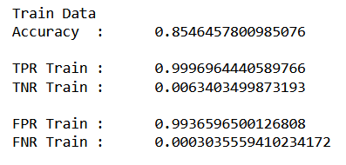
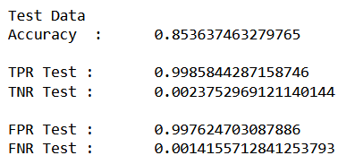
Imbalance of dataset
Both Training & Testing Datasets have accuracy above 85%
High TPR & low FNR
BUT
Low TNR & high FPR
It has more difficulty accurately identifying charged off loans

Slide 15


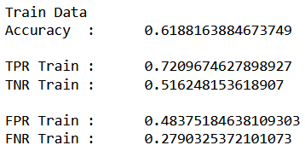
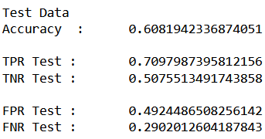
Resampling of Data [Upsampling]
BEFORE
AFTER

Slide 16
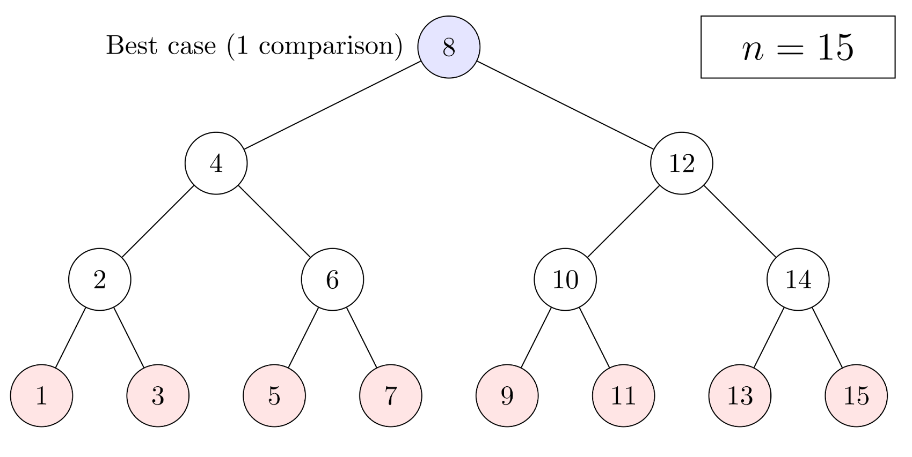

Hyperparameter Tuning
Experiments:
100 Trees + 4 Depth
1000 Trees + 4 Depth
100 Trees + 10 Depth
1000 Trees + 10 Depth
Finding for best fit estimators
Increasing the number of trees has led to better capturing of patterns
More depth has led to better performance
Adjusting ‘min_samples_split’ can help reduce overfitting

Slide 17
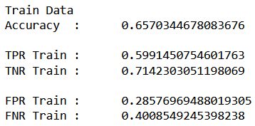
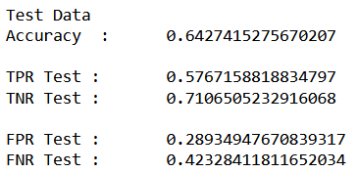
Decision Tree Classifier
Why this model?
Transparent & easy interpretation of loan status predictions
Handles non-linear relationships
Handles Mixed data types
Findings:
Consistent performance for both training & testing datasets due to similar TPR & TNR values
Struggles more with correctly classifying ‘Charged Off’ compared to ‘Fully Paid’ loans
FNR is relatively high (40.08%)
Overall accuracy is around 64-65%
TP: Correctly predicted as "Fully Paid"
TN: Correctly predicted as "Charged-Off"
FP: Incorrectly predicted as "Fully Paid" (actually "Charged-Off")
FN: Incorrectly predicted as "Charged-Off" (actually "Fully Paid")

Slide 18
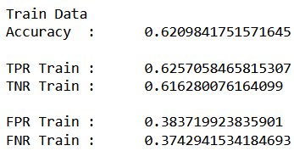
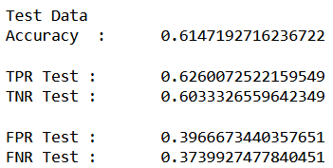
Logistic Regression
Why this model?
Suitable for binary classification tasks
Provides probabilities for outcomes like the likelihood of loan
Includes linear decision boundary through linear relationships
Findings:
Balanced performance for both training & testing datasets based on their accuracies
Misclassification of loan status
FPR is relatively high (38-40%)
FNR is relatively high (37%)
Overall accuracy is moderate (61-62%)
TP: Correctly predicted as "Fully Paid"
TN: Correctly predicted as "Charged-Off"
FP: Incorrectly predicted as "Fully Paid" (actually "Charged-Off")
FN: Incorrectly predicted as "Charged-Off" (actually "Fully Paid")

Slide 19
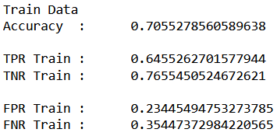
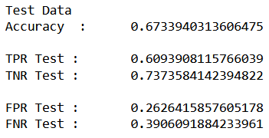
Random Forest Classifier
Why this model?
Reduces overfitting and enhances generalisation
Handles Categorical Data using Label Encoding
Findings:
Good performance on both the training & testing datasets
FPR is relatively low (23-26%)
TPR & TNR are relatively high
Overall accuracy is relatively high as compared to other models (66-71%)
TP: Correctly predicted as "Fully Paid"
TN: Correctly predicted as "Charged-Off"
FP: Incorrectly predicted as "Fully Paid" (actually "Charged-Off")
FN: Incorrectly predicted as "Charged-Off" (actually "Fully Paid")
Notes:
#### Best Model and Score from Randomized Search Cross-Validation
Best max_depth: 9;
Best n_estimators: 900;
Best Cross-Validation Accuracy: 65.55%

Slide 20
Comparison of Models
Model | Classification Accuracy Score | True Positive Rate (TPR) | False Positive Rate (FPR)
Decision Tree Classifier | Train: 65.70% Test: 64.27% | Train: 59.91% Test: 57.67% | Train: 28.58% Test: 28.93%
Logistic Regression | Train: 62.10% Test: 61.47% | Train: 62.57% Test: 62.60% | Train: 38.37% Test: 39.67%
Random Forest Classifier | Train: 70.55% Test: 67.34% | Train: 64.55% Test: 60.94% | Train: 23.45% Test: 26.26%
Random Forest Classifier achieved the highest accuracy
among all the models.
Relatively higher true positive rate
Relatively lower false positive rate

Slide 21
Insights & Recommendation
Insights
Recommendations
Hyperparameter Tuning: Using techniques like Random Search helped in finding the best set of hyperparameters to optimize model performance.
Models should be regularly monitored and updated to maintain accuracy as data distributions and customer behaviors evolve
Handling Imbalanced Data: Using techniques like upsampling ensured equal representation of classes and helped to improve accuracy of the models
Could have explore other ensemble methods such as Gradient Boosting Machines, AdaBoost, or XGBoost to improve predictive performance and can often outperform individual algorithms
By considering a range of evaluation metrics beyond accuracy, we gained a more nuanced understanding of model performance.

Slide 22
THANK
YOU!

